Slide 1
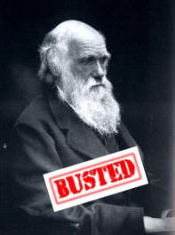
Famous
Frauds &
Hoaxes
Notes:
The Evolutionary hypothesis is the single strongest tool used in our time to attempt to destroy faith in God because so many people are tricked into believing it is actually a scientific premise. However, Evolutionists themselves have gone on record in suggesting that the evidence is actually very weak. And this weakness so transparent that some Evolutionists, in denial about its weakness, have resorted to fraud in order to propagate it. Evidence has been fabricated, passed on and published as science, only for someone to come along and expose it. Others, like Darwin, have simply made observations from nature and then packaged those observations into evolutionary hypotheses and made them out to be the only viable explanations while dismissing Creationist observations. These evolutionary misrepresentations, many of which are still taught in text books, will be the subject of our next discussion. This discussion is going to be addressing specific hoaxes and frauds.

Slide 2
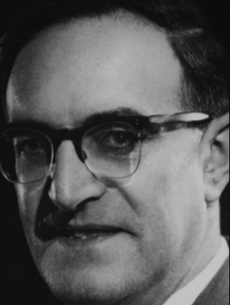
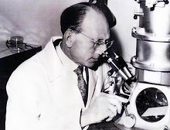
Evolutionists Admit
Henry Lipson – “Evolution became in a sense a scientific religion; almost all scientists have accepted it and many are prepared to ‘bend’ their observations to fit in with it.” (A Physicist Looks at Evolution, Physics Bulletin, V. 31, n.d. 1980)
Pierre-Paul Grassé – “Biologists must be encouraged to think about the weaknesses and extrapolations that theoreticians put forward or lay down as established truths. The deceit is sometimes unconscious, but not always, since some people, owing to their sectarianism, purposely overlook reality and refuse to acknowledge the inadequacies and falsity of their beliefs.” (Evolution of Living Organisms, 1977, p. 8)
Notes:
This is not Creationist propaganda. We are not the only ones saying there have been frauds. Even well-known Evolutionists have admitted to using false evidence to support their data.
Dr. Henry Lipson, an Evolutionists, was head of the department of Physics at Manchester University – “Evolution became in a sense a scientific religion; almost all scientists have accepted it and many are prepared to 'bend' their observations to fit in with it.”
Pierre-Paul Grassé – “Biologists must be encouraged to think about the weaknesses and extrapolations that theoreticians put forward or lay down as established truths. The deceit is sometimes unconscious, but not always, since some people, owing to their sectarianism, purposely overlook reality and refuse to acknowledge the inadequacies and falsity of their beliefs.”
So get ready. Buckle up. I am going to show you some frauds and hoaxes that will simply shock you. Its so verbatim and shocking, you’ll almost wonder whether they’re true. But everything I’m going to show you is well documented and easily researched on the internet and other publications.

Slide 3
What Sayeth Scripture?
Acts 13:10 – “You who are full of all deceit and fraud, you son of the devil, you enemy of all righteousness, will you not cease to make crooked the straight ways of the Lord?”
2 Cor 11:13-14 – “For such men are false apostles, deceitful workers, disguising themselves as apostles of Christ. No wonder, for even Satan disguises himself as an angel of light.”
Col 2:8 – “See to it that no one takes you captive through philosophy and empty deception, according to the tradition of men, according to the elementary principles of the world, rather than according to Christ.”
Notes:
But before we get into the specific frauds, I want to share with you some verses that hopefully will remind us that deceit of the magnitude I’m going to show you should not be surprising at all:
Acts 13:10 – “You who are full of all deceit and fraud, you son of the devil, you enemy of all righteousness, will you not cease to make crooked the straight ways of the Lord?”
2 Cor 11:13-14 – “For such men are false apostles, deceitful workers, disguising themselves as apostles of Christ. No wonder, for even Satan disguises himself as an angel of light.”
Col 2:8 – “See to it that no one takes you captive through philosophy and empty deception, according to the tradition of men, according to the elementary principles of the world, rather than according to Christ.”

Slide 4
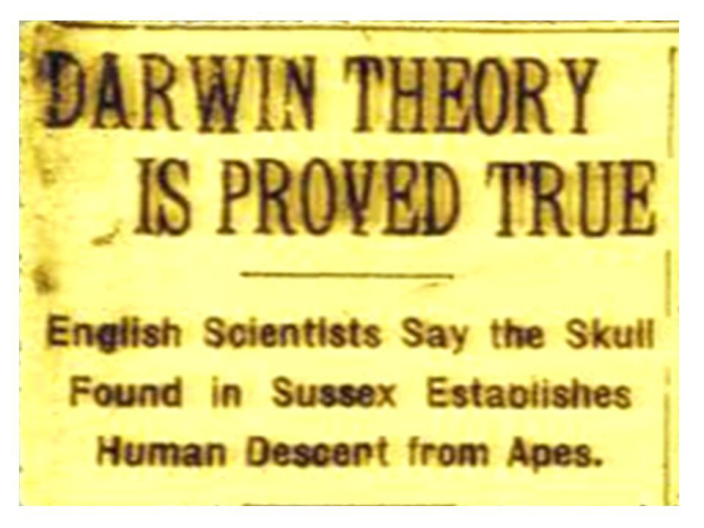
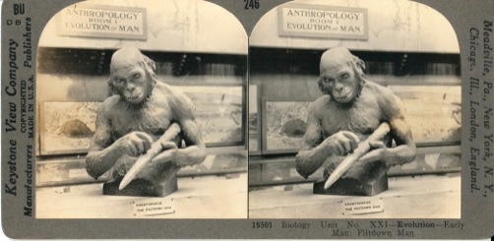
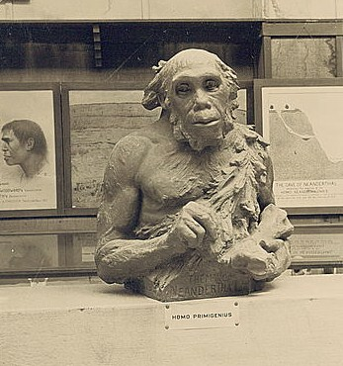
The Piltdown Man
Notes:
This first one is a hoax from 1912 called “The Piltdown Man” now known as “The Piltdown Man Hoax”.
So Charles Darwin published his first book, “On The Origin of Species” in 1859 which claimed that all animal life originated from a common ancestor and then gradually evolved up. Then in 1871, he published another book called “The Descent of Man” where he stated that not only did all animal life originate from a common ancestor, but he included mankind in that as well. Well, for the next 40 years Creationists called foul claiming there was no scientific evidence for the claim that man came from primates (apes), but that it was merely another one of Darwin’s unsubstantiated hypotheses meant to satisfy depraved minds. Guess how did Evolutionists responded? They basically said, “If we can’t find the evidence, we’ll invent the evidence.”
So in 1912, amateur archeologist Charles Dawson found a jawbone and a piece of a skull, claiming it was the missing link between primates and humans, and dubbed it the “Piltdown Man”. Models were created based on the skull shape to show what Piltdown Man looked like, as seen in these pictures on the right. The skull was then placed in the British Museum where for 40 years hundreds of thousands of people were shown it and told “This is where you came from”. And so a couple generations of people died believing this was their ancestor.

Slide 5
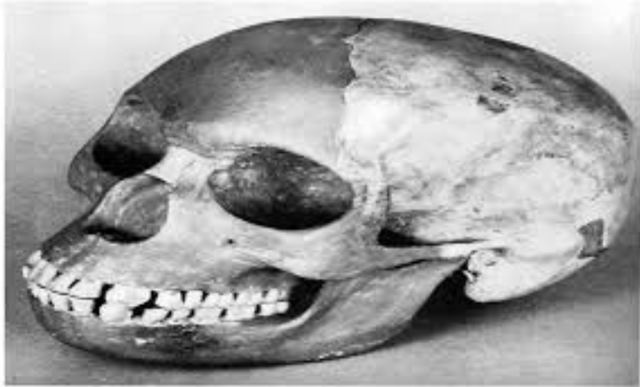
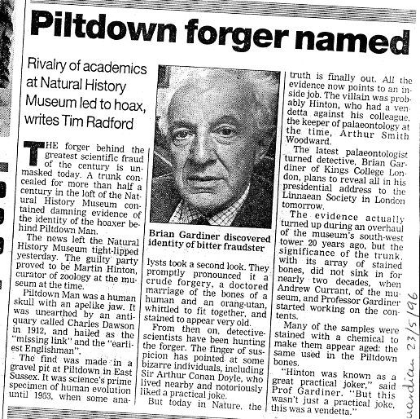
The Piltdown Man
Human Skull
Orangutan Jaw
Notes:
Then in 1953, scientists reexamined the jawbone and discovered it was a fake. The skull was found to be a human skull and the jawbone and teeth were from an orangutan.
“Well maybe Dawson didn’t know any better.” The teeth of the jawbone had been filed down to make them look human. The bones and the teeth had been chemically treated and painted to give them the appearance of being ancient. The Piltdown Man hoax was such an embarrassment to the UK scientific community that they opened a probe about it in Parliament.
That’s bad enough. But here is what’s worse. For 40 years, scientists and others writing doctoral theses had access to these bones, and they were intensely studied. But for 40 years, no one saw the fraud even though afterwards it seemed obvious. How could highly qualified scientists miss this? Perhaps the reason is because it was what they were looking for; its what fit their preconception. Evolutionary scientists so believed that man evolved from apes that they were blind to the hoax, and so they uncritically accepted Piltdown Man as being genuine.
What this should remind us of is that being a scientist doesn’t protect you prejudice and make you a neutral seeker of truth. Evolutionists interpret their finds within their evolutionary worldview. And this is a great reminder to Christians in our evangelism with Evolutionists. We’re not out to denigrate evolutionists as foolish, especially since Christians get taken in by hoaxes too. We need to encourage others as well as ourselves that facts need to be interpreted and our worldview “glasses” will often determine to a large extent how we see the facts. And perhaps by breaking the myth that somehow Evolutionary scientists are more objective than Christians can break down many of the barriers that exist as we attempt to introduce people to the bible and Jesus Christ.

Slide 6
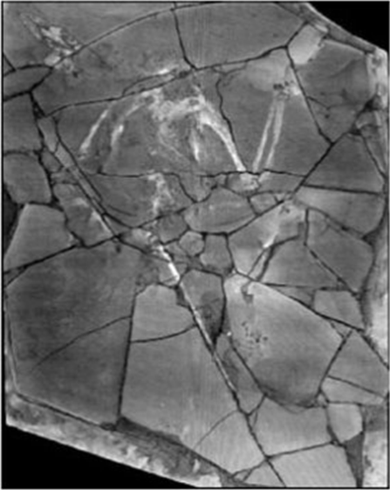
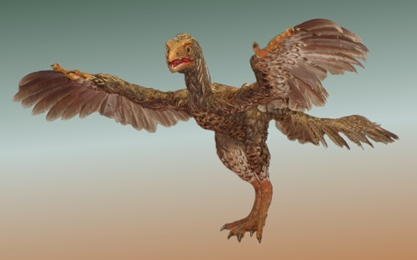
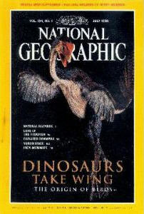
Archaeoraptor
Notes:
In 1999, a fossil was discovered in China dubbed “Archaeoraptor”, depicted in the picture on the left. When you examine the fossil, it looks like a dinosaur with feathers and the picture on the right was a model someone made of what they thought it looked like. This discovery was in every major scientific magazine. NPR covered it. It was on the cover of the New York Times.
Evolutionists claimed, “Here it is! The missing link between dinosaurs and birds has finally been found. The arms of a primitive bird and the tail of a dinosaur.
However, academic journals refused to publish it. Why? Because they demanded peer to peer review to ensure it wasn’t a fake. It is a well known fact that poor Chinese farmers are the ones who unearth many of the fossils found in China and seeking a quick buck, they sell them to dealers. High quality fossils can sell for as high as tens of thousands of dollars which is a lot of money to a farmer who makes only a few dollars every month.
But National Geographic took a big risk. Despite being turned down by academic papers, National Geographic decided to go ahead and publish a description of this newly found species.

Slide 7
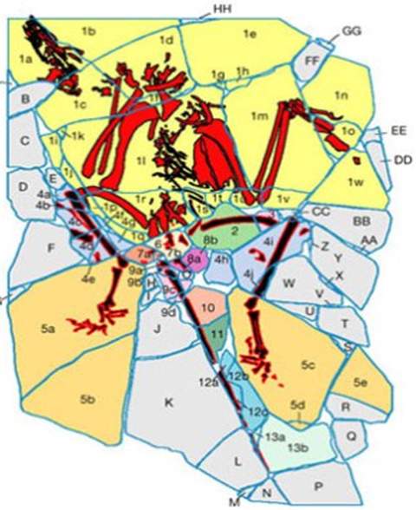
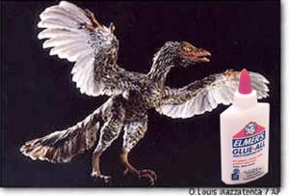
Archaeoraptor
Storrs Olson – “National Geographic has reached an all-time low for engaging in sensationalistic, unsubstantiated, tabloid journalism…it eventually became clear to me that National Geographic was not interested in anything other than the prevailing dogma that birds evolved from dinosaurs…Sloan’s article takes the prejudice to an entirely new level and consists in large part of unverifiable or undocumented information that ‘makes’ the news rather than reporting it.” (Open letter to: Dr Peter Raven, Secretary, Committee for Research and Exploration, National Geographic Society)
Notes:
But when they shipped it back to the US, American Paleontologists examined it. Guess what they found out? They found that it was indeed a dinosaur and there were indeed feathers, but that someone had simply taken 3 to 7 different fossils and jig-sawed them together.
This fraud was so brazen, Storrs Olson, who was Curator of Birds at the Museum of Natural History of the Smithsonian Institute in Washington D.C. said:
“National Geographic has reached an all-time low for engaging in sensationalistic, unsubstantiated, tabloid journalism…it eventually became clear to me that National Geographic was not interested in anything other than the prevailing dogma that birds evolved from dinosaurs…Sloan’s article takes the prejudice to an entirely new level and consists in large part of unverifiable or undocumented information that ‘makes’ the news rather than reporting it.” (Open letter to: Dr Peter Raven, Secretary, Committee for Research and Exploration, National Geographic Society)
This hoax has since became known as the “Piltdown Chicken”.

Slide 8
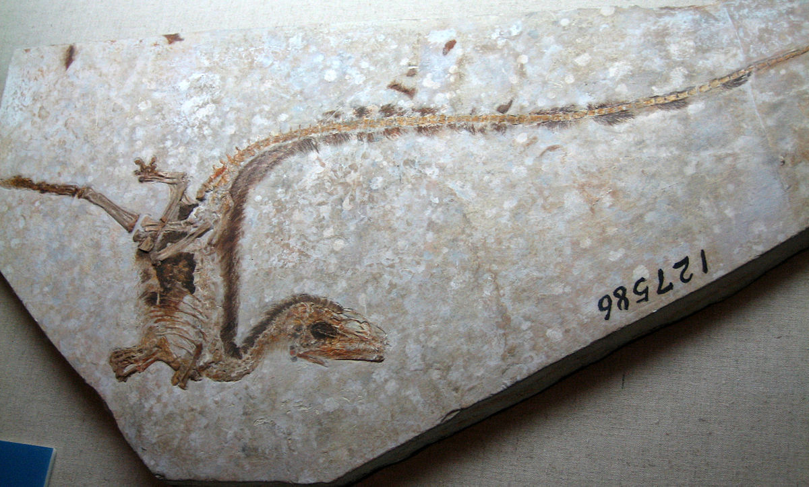
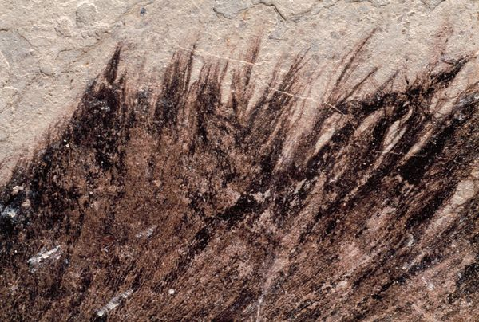
Sinosauropteryx
Ann Gibbons – “Exactly 1 year ago, paleontologists were abuzz about photos of a so-called ‘feathered dinosaur,’ which were passed around the halls at the annual meeting of the Society of Vertebrate Paleontology. The Sinosauropteryx specimen from the Yixian Formation in China made the front page of The New York Times, and was viewed by some as confirming the dinosaurian origins of birds. But at this year's vertebrate paleontology meeting in Chicago late last month, the verdict was a bit different: The structures are not modern feathers, say the roughly half-dozen Western paleontologists who have seen the specimens…Paleontologist Larry Martin of Kansas University, Lawrence, thinks the structures are frayed collagenous fibers beneath the skin-and so have nothing to do with birds.” ("Plucking the Feathered Dinosaur," Science, vol. 278, no. 5341, 14 November 1997, pp. 1229 – 1230)
Notes:
Unable to find what they were looking for in the Archaeoraptor, Evolutionists placed their hope in another fossil found 3 years earlier in 1996 that was dubbed Sinosauropteryx. Certain Paleontologists who examined it said, “Look, bird feathers!” Again, this is significant because evolutionists have been trying to prove for years that birds evolved from dinosaurs and massive amounts of spending is done trying to locate a dinosaur with feathers in it.
But then just a year later, after it made it headlines, it was debunked. Paleontologists examined it admitted it wasn’t a feather at all, but just scales going down its back. Evolutionists followed suit. But this was only after it made waves.
“Exactly 1 year ago, paleontologists were abuzz about photos of a so-called "feathered dinosaur," which were passed around the halls at the annual meeting of the Society of Vertebrate Paleontology. The Sinosauropteryx specimen from the Yixian Formation in China made the front page of The New York Times, and was viewed by some as confirming the dinosaurian origins of birds. But at this year's vertebrate paleontology meeting in Chicago late last month, the verdict was a bit different: The structures are not modern feathers, say the roughly half-dozen Western paleontologists who have seen the specimens. ...Paleontologist Larry Martin of Kansas University, Lawrence, thinks the structures are frayed collagenous fibers beneath the skin-and so have nothing to do with birds.”

Slide 9
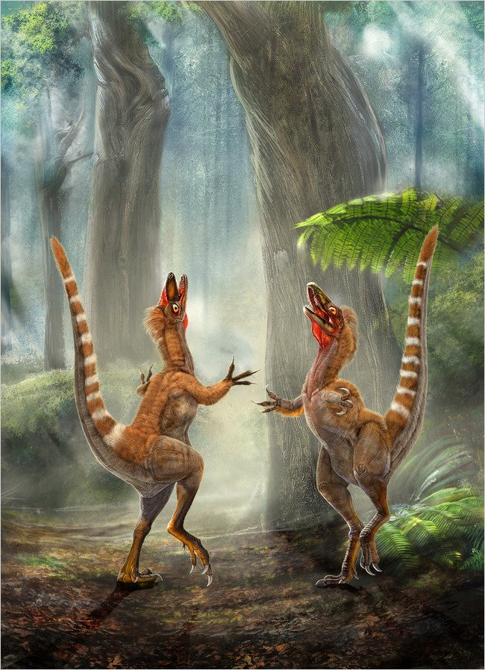
Sinosauropteryx
Prov 18:13 – “He who gives an answer before he hears, it is folly and shame to him.”
Prov 18:17 – “The first to plead his case seems right, until another comes and examines him.”
Prov 20:25 – “It is a trap for a man to say rashly, ‘It is holy!’ and after the vows to make inquiry.”
Notes:
But this is one of the renderings that went around during the time when it was suggested that it was the missing link between dinosaurs and birds.
This may be a good time to mention that when these frauds keep stacking up, Evolutionists, in their defense will put a positive spin on it by saying, “Well, that’s the nature of science, it is self correcting.” in order to justify it. We would never discount this about science and we are glad when the corrections are made.
The issue is not just the fact they are frauds. The issue is the clumsy, jumping the gun, desperation mentality that says “We’ve got to put this out there before the public!” because they’re wanting to prove Evolution so badly. Many of these scientists are not driven by honesty and integrity, but status and rewards, seemingly oblivious to the consequences. See, as people buy into these frauds, it further weakens those whose faith is hanging by a thread, and thousands if not millions of people die starting to believe the bible is a hoax because what “science” keeps discovering.
Let this be a lesson for us. Whenever scientists or the publications that give them a voice publish something sensational, always take a wait-and-see approach. There may be more to it than meets the eye.
Prov 18:13 – “He who gives an answer before he hears, it is folly and shame to him.”
Prov 18:17 – “The first to plead his case seems right, until another comes and examines him.”
Prov 20:25 – “It is a trap for a man to say rashly, ‘It is holy!’ and after the vows to make inquiry.”

Slide 10
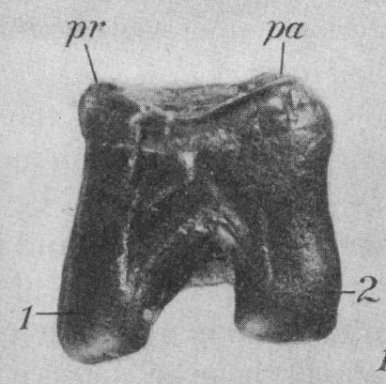
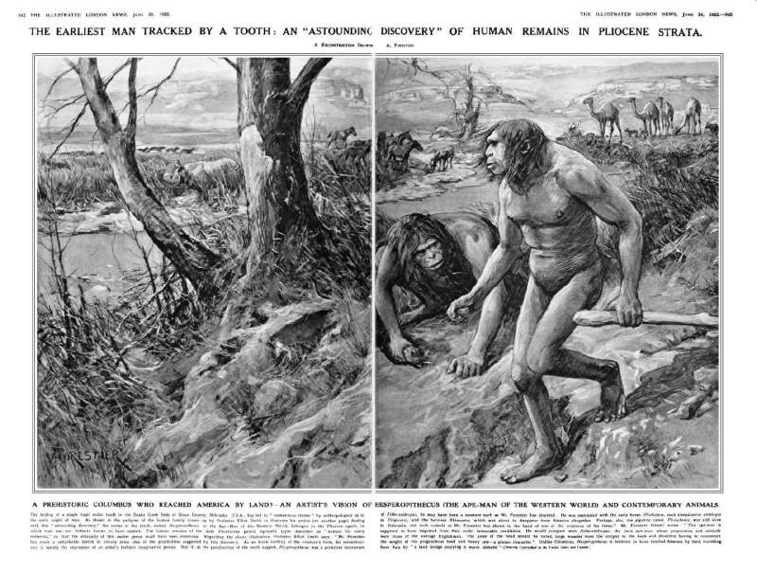
The Nebraska Man
Notes:
In 1917, a geologist named Harold Cook, unearth a molar tooth in Nebraska. That was it. One single molar tooth. He kept it for 5 years but then in 1922 turned it over to his good friend Henry Osborn. Now Osborn was a former president of the American Museum of Natural History and a prominent member of the ACLU (let that sink in we’ll come back to it). Together they proclaimed, “Here is your ancestor, people, Nebraska Man!” And the artwork was constructed as you can see in the picture based on just this one tooth, one single tooth. That was their evidence.

Slide 11
The Nebraska Man
Notes:
However, 3 years later, in 1925, a man named William King Gregory completed the excavation in Nebraska and his team found the full skeleton of Nebraska Man, minus the molar. The entire skeleton was there minus this one tooth that someone how got removed. And guess what Nebraska Man turned out to be? It turned out to be Nebraska Pig! More specifically, a peccary which is a close relative to the pig.
So surely this was a mistake right? They would have never done this intentionally. My wife will tell you that one of my weaknesses is I tend to give people the benefit of the doubt longer than I should so even I at the time might have been the first to cry, “So it was a mistake. Admit it and lets move on.” There’s actually more to it.

Slide 12
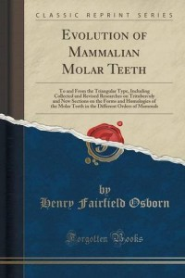
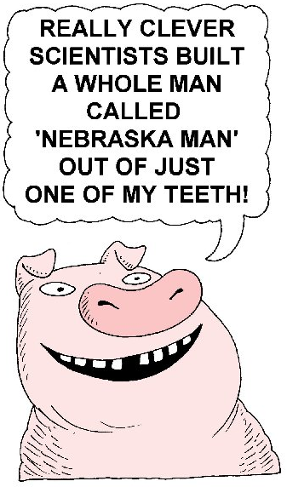
The Nebraska Man
Notes:
This is a book written by the one and only Henry Osborn who worked with his friend Harold Cook to fabricate the Nebraska Man hoax. In this book, Osborn documents his keen knowledge of peccary molars noting in the book that they could be mistaken for anthropoid molars “by anyone not familiar with the dentition of Miocene peccaries”. Folks, this book was written in 1909, 8 years before the discovery of the tooth and 13 years before they went forward with it. Why then would they have proclaimed that a pig molar, of which they were very familiar and knowledgeable, was proof of an ape-man, a missing link?
The evidence is strong that this fraud was deliberate, especially considering that Osborn was such a prominent member of the ACLU, who was at that time trying to challenge the state laws that prevented the teaching of Evolution in class rooms, which was what led to the famous Scopes trial of Dayton, TN.
Someone once said that the only thing this proved is how a pig could make a monkey out of a man.
http://thecreationclub.com/the-frauds-of-evolution-5-the-nebraska-man-hoax/

Slide 13
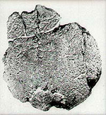
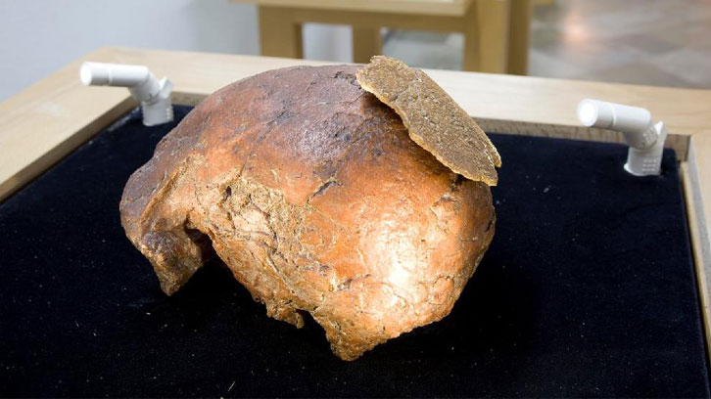
Orce Man
Notes:
In 1982, a skull fragment was found in the southern Spanish town of Orce in the province of Granada. Scientists claimed that it belonged to a 17 year old man who lived 900,000 to 1.6 million years ago and so it was heralded as the oldest fossilized human remains to ever be found in Europe. There were detailed drawings constructed of what this “Orce Man” would have looked like as you can see in the bottom picture.
Now interestingly, the skull fragment was attached to a rock and so its inner part was not visible. But it was released to the public anyway and it was received enthusiastically by journalists, and headlines such as “Discovery of the Century” started appearing in newspapers.

Slide 14
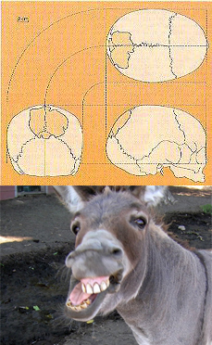
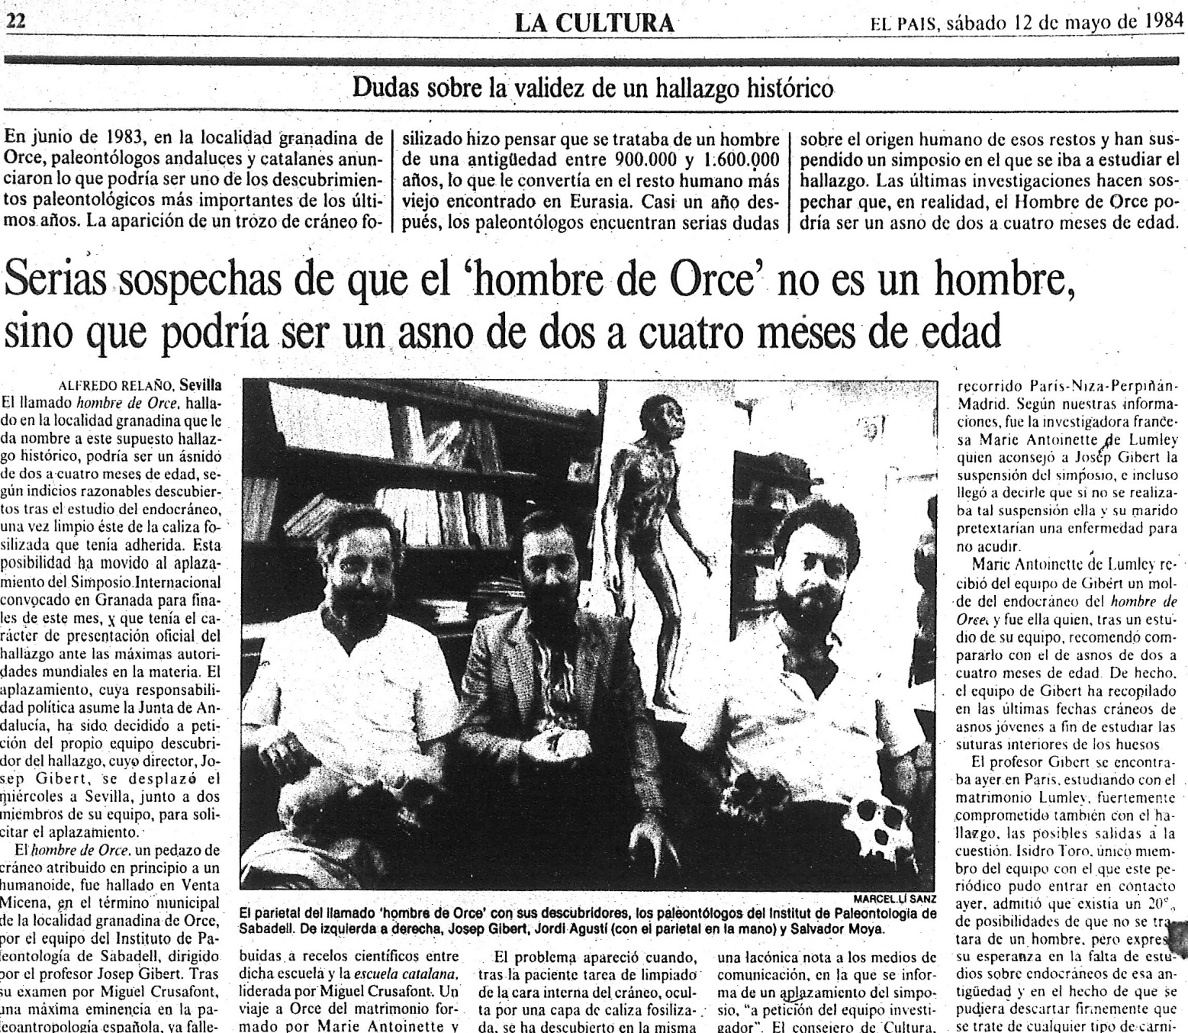
Orce Man
Notes:
Well, only after all this pomp and press and publication did they finally remove the skull fragment from the rock. When they did, it wasn’t but a year later that they discovered a ridge inside the skull that clashed with human characteristics. They then took it to France to be examined by experts in anatomy where upon further examination it was discovered that the skull cap probably belonged to a 2 to 4 month old donkey. This embarrassed Spanish officials so much, they sent out 500 letters canceling the symposium where Orce Man was scheduled to be the main topic of discussion.
Why were they so rash in releasing this before properly examining it? It is beyond the scope of this study, but if you research this story you’ll find that there were political motivations involved in Spain that affected the way it was interpreted.
We need to be reminded again that even scientists with their great minds do not operate in some vacuum of neutrality and the “Orce Man” fraud was yet another of several examples that illustrate this. In our evangelistic efforts, we need to continually remind our prospects that this is what happens when you place your faith in scientists.
http://www.uab.cat/web/news-detail/a-country-8217-s-obsession-during-the-construction-of-a-democracy-is-the-orce-man-our-ancestor--1345680342044.html?noticiaid=1345699332163

Slide 15
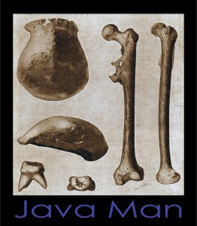
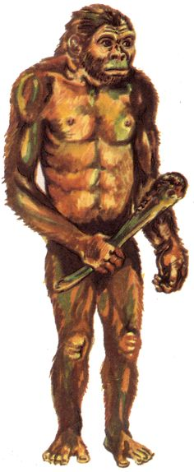
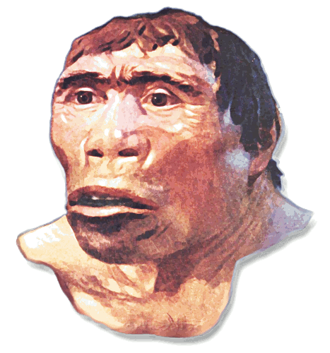
Java Man
“Pithecanthropus erectus”
Notes:
Ernst Haekel was a professor of anatomy and an outspoken advocate of Darwinian Evolution shortly after Darwin’s own time. And he challenged his students to go to Indonesia to look for evidence for Evolution because that is where it would be found. One of his former students, Eugene Dubois, took him up on this in the late 19th century.
Dubois, who was enamored with evolution, set sale to Indonesia intent on finding the elusive missing link between man and monkey. In 1892, he landed on the island of Java and found a thigh bone which to him looked like that of modern humans. A year earlier on the same island he had also found a large skull-cap and 3 teeth. Now the skull-cap and the leg-bone had been found about 50ft away from each other so there was no reason to believe they belonged to the same individual.
But Dubois had the reputation of being highly eccentric in his theories on evolution and so to him this was the missing link and it began to be propagated throughout the world as the missing link between man and ape.
Then drawings started to be constructed. Do you see a pattern here? 1 to 4 bones are found, and then people start generating from this what the entire species looked like from the hair on his body to his weapon of choice. There is no way to tell from just a few bones how much body hair the owner of those bones had. And although no face bones had been found, these are the drawings that they did to reconstruct him. They even gave this new found species the scientific name of “Pithecanthropus erectus” which means “erect ape-man”.

Slide 16
Java Man
Notes:
Well when Dubois presented his findings to the International Congress of Zoology in the Netherlands, it drew a mixed reception even amongst Evolutionists. Even Haeckel’s former professor, Rudolph Virchow, known as the father of modern pathology, argued against it, saying “In my opinion this creature was an animal, a giant gibbon, in fact. The thigh bone has not the slightest connection with the skull.”
So after this criticism, Dubois became secretive and paranoid, refusing to let anyone else examine the bones and he eventually withdrew from the public eye. He refused access to the specimens for the next 20 years. In 1907 a team of German scientists went back to Java and brought back 43 crates of fossil material. When they were finally allowed access to Dubois’ Java Man and researched their own findings, it was discovered that two of the teeth belonged to an Orangutan and the other tooth belonged to a human. The femur bone belonged to a human. Then 30 years later after his find, Dubois disclosed that he also had found human skulls under these fragments.
How could Dubois have misinterpreted the evidence so poorly? The answer is simple: he used Darwin’s scientific point of view approach rather than the well-establish scientific method of investigation. He was merely hoping to find something he could label as the missing link, but he observed these findings merely in the scope of his preconceived theory.
This continues to be a lingering problem amongst many Evolutionary scientists.

Slide 17
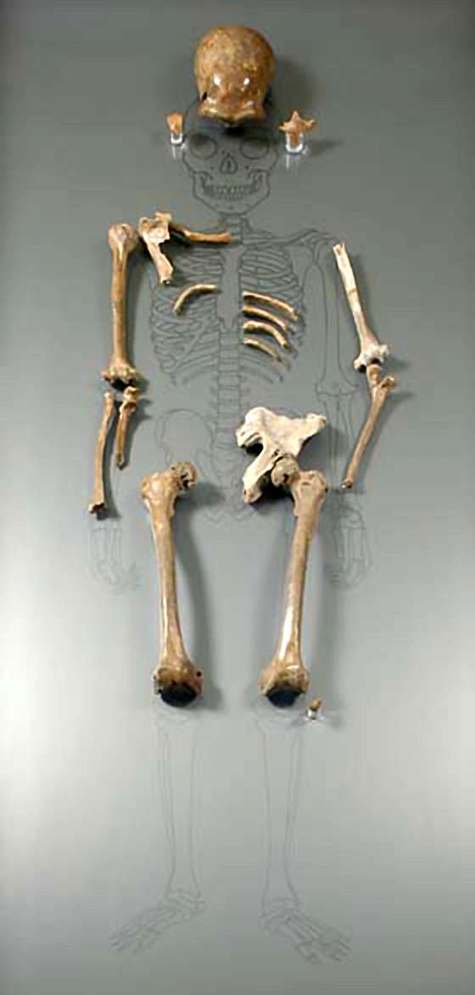
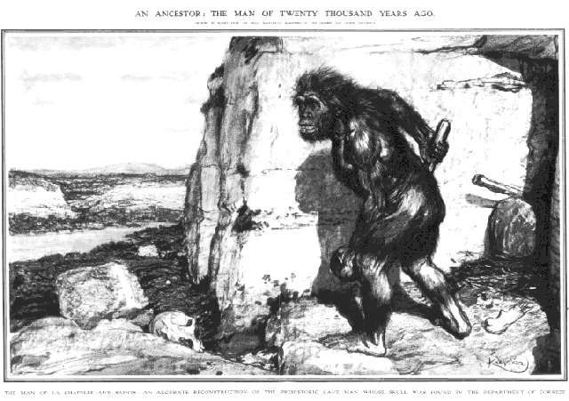
Neanderthal Man
Notes:
“Neanderthal Man” was the title given to skeletal remains excavated in France in 1908. At first, he was given the nickname “The Old Man”. Why? Because when he was examined by expert pathologists at the time, it was concluded that it was simply an old man that suffered from rickets (deficiency in vitamin D) and arthritis. But those conclusions were overlooked by others including Marcellin Boule who took the remains and reconstructed it as being an ape/human hybrid who was ignorant, stooped, and knuckle dragging. He was pronounced the “missing link” between ape and modern man.

Slide 18
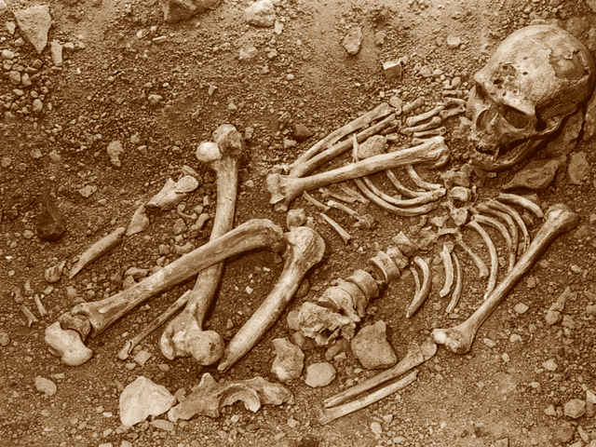
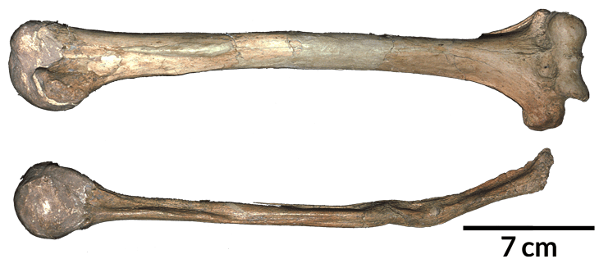
Neanderthal Man
Notes:
But then in 1957, they examined the fossils again and even Evolutionists admitted that Boule had greatly exaggerated the reconstruction and confirmed what pathologists had said 50 years earlier, that the skeletal remains showed evidence of arthritis. Most agree today that Boule’s reconstruction was simply based on bias and preconceived ideas of evolution, yet his work has influenced the conception of Neanderthals for well over a century.
The study of Neanderthal skeletons is still ongoing and there is still debate between Evolutionists and Creationists regarding them. But much of the evidence now suggests that Neanderthals were skilled hunters, believers in an after-life, and even skilled surgeons, as seen in one skeleton whose withered right arm had been amputated above the elbow. (source: "Upgrading Neanderthal Man", Time Magazine, May 17, 1971, Vol. 97, No. 20) (http://content.time.com/time/subscriber/article/0,33009,944380,00.html)
The picture on the right were Neanderthal remains that are on display in Italy that have now been revealed to belong to a man living in the medieval age.

Slide 19
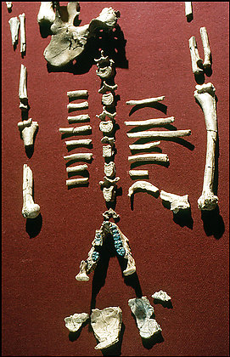
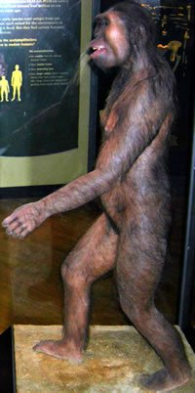
Lucy
Notes:
The remains of a skeleton were discovered in Ethiopia in 1974. Of the 47 bones, it did not include the knee joints. Why is this important? Because that is one of the biggest differences between the monkey and the man, whether or not this particular skeleton was able to stand upright. But desperate for their missing link, the remains were shipped off to the US and dubbed “Lucy”. The picture on the right is of the reconstruction from artists on what those bones looked liked, reflecting more artistic creativity than forensic fidelity. But since then, Lucy has become the cover girl for supposed human evolution.
But Lucy was simply an ape.

Slide 20
Notes:
Why do Evolutionary Scientists feel the need to use fraud and deceit to support Evolution? Because they don’t have any evidence.
Famous Evolutionist Jerry Coyne said the following – “Perhaps such powerful stories discourage close scrutiny. Moreover, in evolutionary biology there is little payoff in repeating other people's experiments”. In other words, Evolutionists find a fossil, invent a story of how it evolved and represents the missing link, and then it goes into a museum. This is not science because they do not test or try to repeat these experiments. They simply use fraud and deceit to fit it into their biased dogma and present it to the world as indisputable evidence.
How can we use these stories to help in evangelism? Not to make scientists look foolish, but to insist that being a scientist doesn’t make you neutral to bias, prejudice, and lies. We need to take the evidence and examine it openly and honestly.

